Slide 1
Dental Programs
Dental Assisting and Dental Hygiene

Slide 2
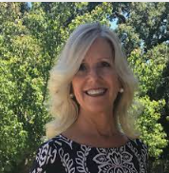
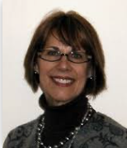
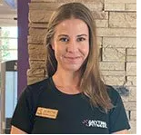
Program Contacts
Cindy (Lucinda) Fleckner:
Dental Hygiene Program Coordinator
Jennifer Poovey:
Dental Assisting Program Coordinator
Yvette Davis:
Administrative Assistant—checks all apps for eligibility

Slide 3
Health Science Program Resources
Binder: https://counselingbinder.santarosa.edu/content/counseling-binder-home
Under SRJC, click on Health Sciences
Dental Programs Website
https://dentalprograms.santarosa.edu/
DH FAQs Page:
https://dentalprograms.santarosa.edu/sites/dentalprograms.santarosa.edu/files/documents/DH%20FAQS%20updated%2011-2021.pdf

Slide 4
Dental Assisting

Slide 5
Dental Assisting
Certificate ONLY
Year to Career
Two semesters and a summer Clinical Practice
No pre-reqs—need high school diploma or GED
If they want to prepare, they can take CS 5 (Computer Literacy) and HLC 160 (Medical Terminology) prior to entering the program. Also good to recommend CSKLS 334 and Coun 60.
Students must provide documentation of a recent health examination, immunization records, and copy of a current CPR card, including adult, child and infant. (American Heart Association or Red Cross)
Have to be in good standing to apply—Website does say this https://dentalprograms.santarosa.edu/prerequisites-dental-assisting-program
3 classes that are core DA and DH classes taken in combined DA/DH courses (DE55A, DE55B and DE51). These courses will be transferred to the DH course load if there is within 5-year recency. This reduces the course load of the DH program in the first 2 semesters and along with the DA education is an advantage to enrolled DH students.

Slide 6
Dental Assisting
Students who have a high school diploma from a school outside the United States must contact Admissions and Records for further information.
Students with foreign degrees can work with Jennifer Poovey to determine eligibility
Complete the application, no transcripts required unless asked for by Admissions and Records.
Application period: January 9th 2023 through March 3rd 2023 (app online only)
Students are notified of acceptance approx. 6 weeks after app deadline
Assist alongside the Dentist
24 students admitted, fall-start only
Full-time program: 8 AM to 5 PM, four days a week. There may be times when a class will be held before 8 AM or later than 5 PM. Approximately 7 hours of outside study each week is required.

Slide 7
Dental Assisting
SRJC Dental Assisting Graduates achieve: 100% employment in their field, have an 161% increase in earnings, and 73% attain the regional living wage. Start approx. $25/hr.
Job Board available
Specific Scholarships available
Jennifer Poovey, Director, Dental Assisting Programs Phone: (707) 535-3788 E-mail: jpoovey@santarosa.edu
Jennifer shared: “Please share that there continues to be a shortage of RDAs! Also share that students must apply to the college and apply to the program. Visiting our website is very informational for colleagues and for students interested in dental assisting and of course dental hygiene too!”

Slide 8
Program Cost

Slide 9
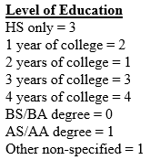
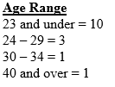
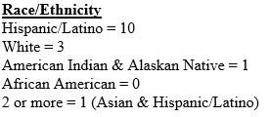
DA 2022 Program Stats
44 applicants (12 more than 2021)
24 accepted but due to some drops and changes only 15 are left
14 females and 1 male
Approx. 60% are Spanish Speaking (increase of 10%)
14/15 are from Sonoma County

Slide 10
Dental HYGIENE

Slide 11
Program Info:
5 semesters (Fall, Spring, Summer, Fall, Spring)
SRJC Dental Hygiene Graduates achieve: 100% employment in their field, have an 176% increase in earnings, and 90% attain the regional living wage
Employment opportunities are available in private and specialty dental offices, health clinics, school systems, research facilities, public health departments, education programs, and marketing and sales of dental products. Salaries for Dental Hygienists range from $35 to $55 per hour.
Almost 100 applicants in 2021 for 24 spots
Majority are from out of area again

Slide 12
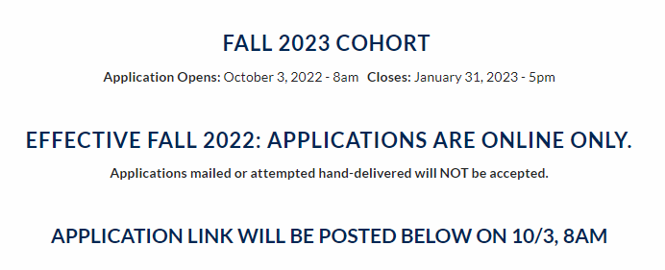
APP TIMELINE: 10/3/22-1/31/23

Slide 13
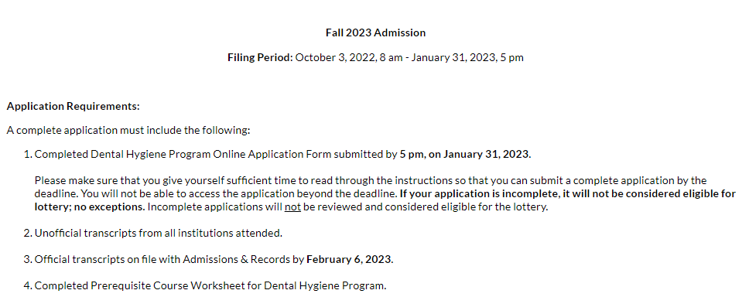
New APP:

Slide 14
Application Instructions
On the DH Website and linked on the application:
https://dentalprograms.santarosa.edu/dental-hygiene-program-process-deadlines

Slide 16
Unofficial Transcripts

Slide 17
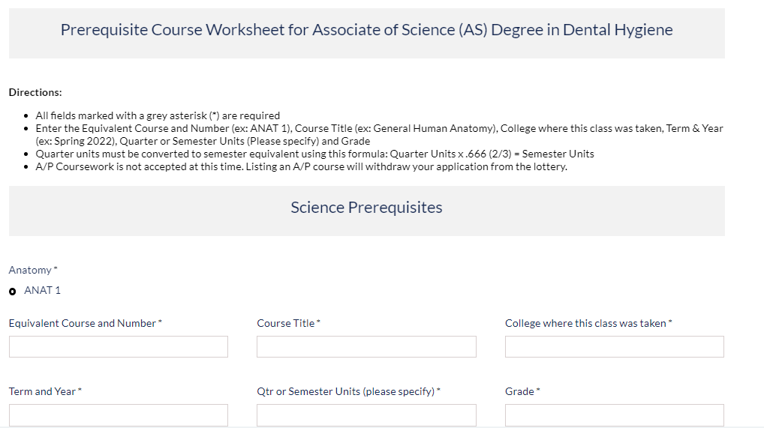
They need to add PLUS and MINUS to grades

Slide 18
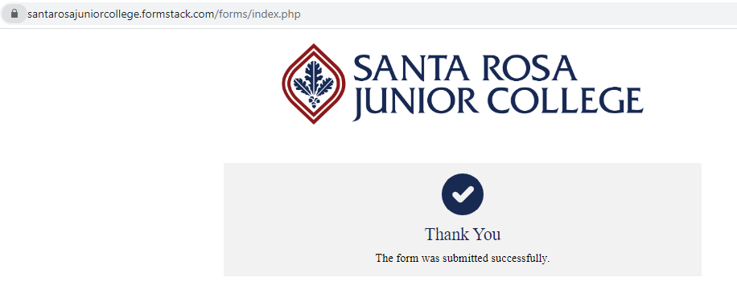
After Submission:

Slide 19
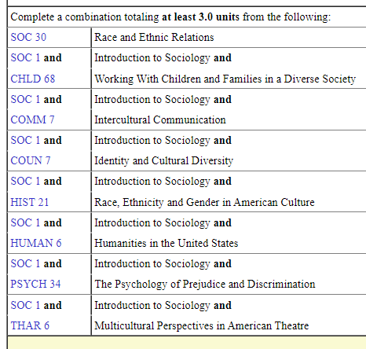
Dental Hygiene Changes
New cohort is held to the diversity requirement:

Slide 20
Reminder for Diversity Requirement:
BLANKET APPROVAL WITH EVAL (in binder):
Students can use any class listed in SRJC GE OPT A area G to pair with Soc 1 Intro to Sociology to meet the Soc 30 Diversity Requirement. This includes classes from transfer institutions found to be equivalent to Soc 1 and any course listed in area G; as well as SRJC’s Anthro 2—Cultural Anthropology.
***After May 2023 cohort students would need to submit a course sub request to use Soc 2 and 10 *****

Slide 21
Blanket Approvals
Added to binder
Foothill College
Sac City College
SRJC Specific Classes

Slide 22
Science Pre-requisites: 2.7 GPA
The Science Pre-req: 2.7 GPA minimum in Anatomy, Physio, Micro and Chem (Chem is on the next slide).
When doing a course sub, the minimum amount of units I’ve seen approved is 3.33 Semester/Quarter Conversion. Any quarter unit, or upper division Science pre-req must be submitted for a course sub.

Slide 23
Chemistry has recently become tricky for some students and Counselors.
Remember, DH needs an intro to Chem (now 3A/3AL) and an Organic Chem (Chem 8). Chem 60 is the best choice if they haven’t taken a Chemistry yet.
Students will ask you what class at their college is equivalent to Chem 60. Be careful with this. You can look at their offerings, and ask an Evaluator to confirm, but Chem 60 does not have a CID yet so it just depends on what our Evaluators will accept.
Our Articulation agreements are up to date. Check there first.
Remember to get into Anat, Physio, Micro students need Chem 60 or Chem 3A/3AL. We no longer accept Chem 42.

Slide 24
Non-Science Pre-Reqs: 2.5 GPA
AP English: TBD as of today, they cannot have AP. This might change.
However if they find a student doesn’t make the cut off, and Yvette notices they have AP she will make sure it’s not something that pushed them over the edge of not qualifying.

Slide 25
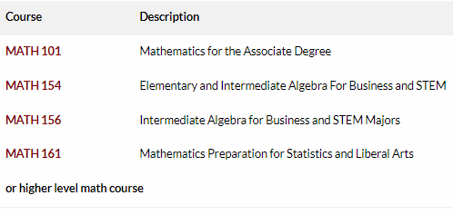
Math
Nutrition
No Changes
“Or higher” does not need a course sub. Neither does Math 155. I added that to the blanket approval.

Slide 26
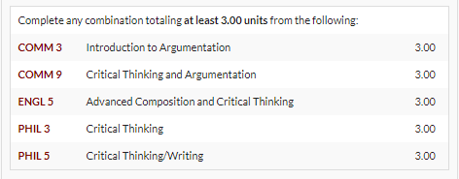
Critical Thinking
#1 Returned Course Sub
If they took the class at another college, and you want to see if it is equivalent, here are some best practices:

Slide 27
Check Articulation Agreements
https://articulation.santarosa.edu/

Slide 28
Blanket Approvals:
Students can use any class listed on the CSU GE Area A3 and IGETC Area 1B as equivalent for the major pre-requisite of Critical Thinking without needing a course sub.

Slide 29
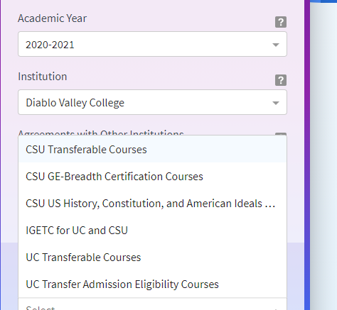
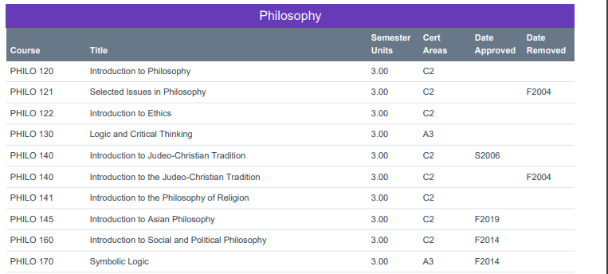
Check Assist.org

Slide 30
Check the CSU & IGETC GE
https://ccctransfer.org/ge/

Slide 31
Course Subs for Critical Thinking
No matter what, you have to pick ONE class from the list to put on the course sub form as closest to equivalent. It cannot be a combination of classes.

Slide 32
Ask Patrice!
Patrice Moore is our current incoming transfer credit Evaluator. You can ask her and get an email that you can then save in the SIS Notes.

Slide 33
Added Comm 7
Added Comm 7
NO CHANGE
NO CHANGE
Took away
Soc 2 & 10.
Potential Sub while phase out
ETHNIC STUDIES:
Soc 30 ideal
Newest Version
Old Version

Slide 34
Dental Hygiene Program Stats
2022
2021
111 total DH applicants, 31 did not qualify so 79 went to lottery.
5 males & 19 females 1 student 40+, 2 students 35-39, the rest are between 23-29 years old
15/24 already had AA/AS degree
11 from Sonoma County; 3 Mendo, 3 Marin, rest are spread out. All intend to go back to their original County after graduation.
Half already work in a Dental Office or have experience
98 applicants and accepted 24 out of the 98
3 males & 21 females 1 student is in the 35-39 year range and the rest are between 23-29 yrs old
17/24 came in already having an AA/AS degree
Half of the class from Sonoma County
9/24 planning to stay in Sonoma County
San Mateo—quite a few are commuting every day
Out of the 24, 11 are registered DA’s

Slide 35
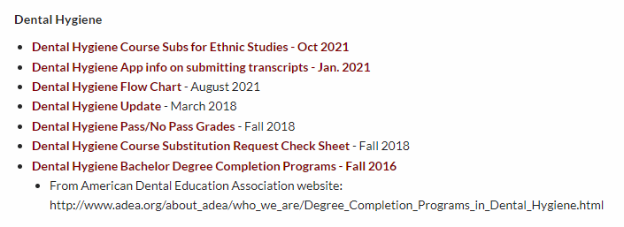
Binder
Flow Chart Updated and once we have AP info I will update again
Will add all blanket approvals

Slide 36
Reminders
To qualify there are two different GPAs (2.7 Science and 2.5 Non-Science)
Articulation agreements are updated and ideal to use
Blanket Approvals are in the binder
Math 155 is ok—no sub needed
Refer students to the website for information on Vaccinations and Clinical Info.
The application is not considered complete without the pre-requisite worksheet but it’s built into the app this year. I had a student email me and say he completely forgot to put it in his envelope last year and they would not accept it past the deadline.
You can save and resume new app for 30 days
Official transcripts ONLY go to A&R now. Deadline is past the app deadline (Feb 6 2023 for transcripts and Jan 31 2023 for app)
No recency requirements on Sciences
All pre-reqs have to be completed with a grade on the unofficial transcript to submit app

