Slide 1
My First semester
Education Planning workshop
Santa Rosa Junior College Counseling department

Slide 2
Workshop overview
Academic Goals
Transfer Options
Course Selection
English and Math Placement
College Support Programs
Your Student Education Plan
Next Steps

Slide 3
Educational Options
Certificate
Associate Degrees (AA,AS, AS-T)
Transfer
Learn new job skills
Personal enrichment

Slide 4
Certificates versus majors
Certificates are focused areas of study (vocation)
Hands-on curriculum taught by professionals and shaped via Advisory Boards with industry leaders
SRJC offers over 100 certificates
Majors are an area of study, general education (GE) and possibly electives.
To earn an Associate Degree a student must complete a major course of study of at least 18 college units from the SRJC list of approved majors and GE completion
A major provides coherence, focus, depth, sequencing, and synthesis of learning. A course may be used to satisfy both a General Education (GE) requirement and a major requirement

Slide 5
The Class Schedule
The online class schedule will give you the following information
Course prefix and number (English 1A) and course title
Location (Santa Rosa, Petaluma, Shone Farm, Roseland, Public Safety)
Modality (in person, online, hybrid)
Instructor
Class size
Units
Important dates (last day to add, get a refund, drop, etc)

Slide 6
How to read the schedule of classes

Slide 7
Description provides a brief Explanation of the course Course outline to get the detailed description of class

Slide 8
Ways to take a class
In Person – Fully on campus at the scheduled time and location
Online synchronous – delivered at specified time but via zoom (not on campus)

Slide 9
Ways to take a class
Online asynchronous – Students complete their coursework without ever being required to be “live” with their instructor. There is no zoom required.
Hybrid – Some portion of the class is in person and the rest online

Slide 10
Creating your first semester schedule
Write down classes that are of interest to you
Do you want to be enrolled full-time (12 or more units) or do you want to be enrolled part-time (less than 12 units)?
Are you interested in a certificate? If so, which one(s)
Are you interested in transfer? If so, CSU, UC, Private
You know you want to be in school but you have no idea if you want a certificate or transfer
What support may you need? Tutoring, financial aid, disAbility Resources, registration assistance, scholarships, etc?
Will you be a student athlete?
Are you an international student?

Slide 11
Creating your first semester schedule
Are your English and Math placements in your student portal?
Did you complete any College Board AP or IB exams in high school?
Be sure to write the name of the exam(s) and score(s) on your ed plan.
If you don’t know your score, write the name of the exam and score unknown
Did you take coursework at another college? (we need transcripts)
Are your AP/IB/transcripts on file with the SRJC Admissions and Records Office?
You will need to complete a Transfer Credit Evaluation request
You may need to petition for Equivalency

Slide 12
Where to find your English and math placements in your student portal

Slide 13
Which English and Math Class should I take?

Slide 14
English and Math
English
English 1A: College Composition is required for an AA/AS degree and transfer for all students. Recommended in your first semester
English 50 may be recommended/required pending your high school GPA
ESL 10: This class is for non native English speakers and is equivalent to English 1A
Math
The math class you will take depends on your major/goal
It is not required to take it in our first semester but is recommended for STEM majors
Math should be completed either in your first semester if a STEM major or in your second semester
Some sections are linked with co-requisites

Slide 15
Understanding your math placement

Slide 16
Which Math should I take?
Social and Behavioral Science majors | Science, Tech, Engineering and Mathematics (STEM) | Business | Arts and Humanities | AA/AS Degree (without transfer)
Math 15 Elementary Statistics or | Math 27 Precalculus Algebra & Trigonometry or | Math 15 Elementary Statistics and | Math 10 Nature of Mathematics or | Math 10 Nature of Mathematics or
Psychology 9 Behavioral Statisics or | Math 25 Precalculus Algebra and | Math 9 Finite Math or | Math 15 Elementary Statistics or | Math 15 Elementary Statistics or
Math 10 Nature of Mathematics | Math 58 Precalculus Trigonometry | Math 16 Intro to Math Analysis | Psychology 9 Behavioral Statisics | Psychology 9 Behavioral Statisics
 | Math 1A Calculus, First Course

Slide 17
Which Math should I take?
Math 200 (2 units) B-STEM Concurrent Support, may be required with your Math 9 & Math 25 course.
Math 215 (2 units) Elementary Statistics Concurrent Support, is required for students who did not pass Algebra 2 or Integrated Math 3 and is recommended for students with a GPA less than a 2.7
Math 225 (4 units) Precalculus Algebra Concurrent Support

Slide 18
Certificate options
Review the certificate website and identify which is of interest to you.
Reminder: If your goal is a certificate only, you are not required to complete a general education pattern.

Slide 19
Transfer options Have you ever heard . . .?
“Just go to the JC for 2 years and do your GE.”
The Transfer Process requires much more than general ed
The amount of time you spend at SRJC depends:
Major – Science/Engineer majors require more coursework
Work Schedule
Family Responsibilities
Life circumstances
Dropping/Failing/Repeating Classes

Slide 20
What does it mean to transfer?
SRJC
BACHELOR’S DEGREE
GRADUATE DEGREES
UC
CSU
PRIVATE SCHOOL (CA)
OUT-OF-STATE
MASTER'S
PHD
DDS/MD (DOCTOR)
JD (ATTORNEY)
GENERAL ED
MAJOR PREP
REQUIRED UNITS/GPA
ASSOCIATE’S (NOT REQUIRED TO TRANSFER)

Slide 21
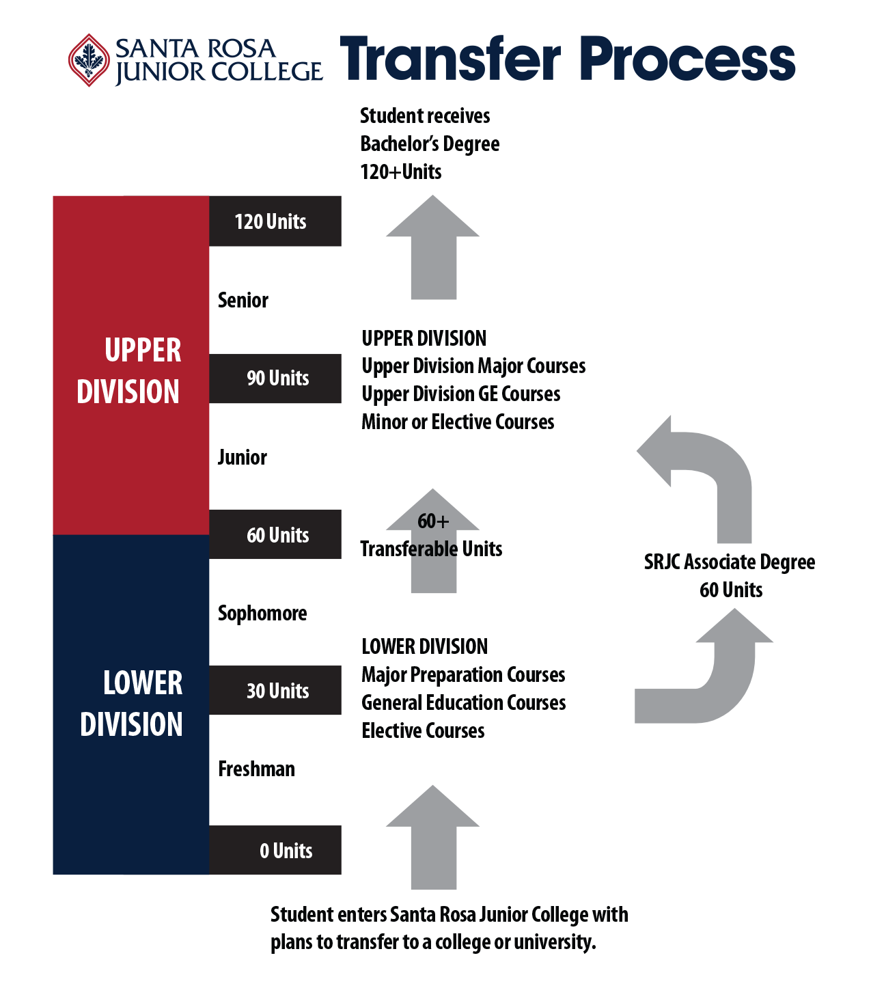
What you do at the 4-year
What you do at SRJC

Slide 22
Transfer Requirements
= 60 units minimum required for UCs/CSUs

Slide 23
CSU Transfer Eligibility Requirements
Minimum
Recommended
60 CSU-transferable units
39-unit CSU GE-Breadth pattern fulfilled and ”certified”, of which 30 units must be with a "C" or better (incl. Areas A and B4)
Lower division major preparation
3.0+ GPA for “impacted” majors or campuses
60 CSU-transferable units
(SRJC courses 1-99)
30 CSU-transferable General Education units, completed with grades of "C" or better, which must include:
All of Area A (Speech, English, Critical Thinking) and Area B4 (a transferable Math class)
2.0+ transferable GPA

Slide 24
UC Transfer Eligibility Requirements
Minimum
Recommended
60 UC-transferable units
SRJC courses # 1 – 47* and up to 4 units of PE “activity” courses
7 General Education courses
2 courses in English Composition
1 course in Mathematics
4 additional courses from at least two of the following GE areas: Arts & Humanities; Social & Behavioral Sciences; Physical & Biological Sciences
2.4+ UC-transferable GPA
60 UC-transferable units
SRJC courses # 1 – 47* and up to 4 units of PE “activity” courses
Lower division major preparation completed
IGETC or campus-specific GE (low-unit majors)
or
7-course minimum GE (high-unit majors)
3.0 - 3.5+ UC-transferable GPA

Slide 25
Understanding Transfer
Attend the Transfer 101 workshop offered by the Transfer Center
Learn about articulation
Learn about impacted majors
Learn about the Transfer Admission Guarantee
Meet with UC, CSU, other campus representatives

Slide 26
General education patterns for those desiring an AA/AS or AS-T degree
General education option A : SRJC
General education option B: CSU
General education option C: IGETC for UC and CSU
Which pattern you pick depends on your overall goal.
Don’t know but know you want to transfer and keep your options open?
Follow option C, IGETC for UC and CSU

Slide 27
Estimated hours per week for College Classes
Full time students = 12 or more units
Part time = 6 or so units
Each unit = 1hour of lesson/class time plus 2-3 hours of student time
12 units = 12 hours of lesson/class time plus 24-36 hours of study time outside of class
Are you working?
If working full-time (40+ hours), we recommend no more than 6 units
If working part-time (20-25 hours) we recommend 12-15 units
We only have 24 hours in a day, 168 hours per week. Time management is critical

Slide 28
Look at the schedule of classes for classes

Slide 29
Let’s start building your first semester plan
What’s your English Placement?
What’s your Math Place?
Certificate?
Transfer?
Undecided? Take Counseling 6
First Year Experience: Counseling 10
Student Success: Counseling 53
Do you want to be part of a Learning Community?

Slide 30
What is a learning community?
Learning communities are linked courses; the same group of students enroll in two or more classes. Learning communities support students’ academic success, build student community, and provide opportunities for campus and community engagement.
Puente
APASSS
UMOJA
Lanzamiento
Avanzando

Slide 31
Building your first semester plan
Things to consider
Working
Family obligations
Are you an athlete?
Are you an international student?
Other?

Slide 32
My first semester
If transfer is your goal
Start by adding English if your goal is an AA/AS degree or transfer
Add a course related to your major if you know it
If you don’t know your major, consider taking Counseling 6
Add two additional general education courses
If a certificate only is your goal
Begin with adding classes related to the certificate
Look at the recommended course sequence

Slide 33
Sample Schedule for a fulltime student
Psychology Major (Transfer) English 1A, 4 units College Composition General education (GE) Psychology 1A, 3 units Introduction to Psychology Major pre and GE Area 3, 3 units (IGETC GE) General education (GE) Comm 1 or 4, 3 units Intro to Public Speaking (GE) | Automotive Tech Certificate Auto 80, 3 units Introduction to Automotive Technology Welding 170, 2 units Beginning Welding: Fundamentals of Arc and Gas Welding Auto 156.1, 5 units Auto Electrical System Mach 51A, 3 units Beginning Machine Tool Technology | Engineering Major (Transfer) English 1A, 4 units College Composition General education (GE) Math 27, 6 units College Alg&Trig OR Math 25, 4 units College Algebra Engr 10, 2 units Intro to Engr Chem 42 or 3A/3AL Introductory or General Chemistry

Slide 34
Sample Schedule for a part time student
Psychology Major (Transfer) English 1A, 4 units College Composition General education (GE) Psychology 1A, 3 units Introduction to Psychology Major pre and GE | Automotive Tech Certificate Auto 80, 3 units Introduction to Automotive Technology Welding 170, 2 units Beginning Welding: Fundamentals of Arc and Gas Welding | Engineering Major (Transfer) English 1A, 4 units College Composition General education (GE) Math 27, 6 units College Alg&Trig OR Math 25, 4 units College Algebra

Slide 35
SOME Required classes for some popular majors
Psychology | PSYCH 1A, BIO 10or16. MATH 15 or PSYCH 9
Kinesiology | KINES 1, BIO 10, MATH 15
Business Administration | BAD 10, MATH 15
Biology | BIO 10, CHEM 42/3A,3AL
Nursing | ENGL 1A, BIO 10, CHEM 60
Child Development | CHILD 10, 51, 90.1, 90.4

Slide 36
Your Student portal
This ed plan will be added to your student portal
It can be accessed under the Admissions and Registration section or the MyRecords Section
Use the classes on the ed plan to register for classes during your priority registration date and time

Slide 37
Student Support Services be sure to take advantage of our many services
Think about what services you may want to access?
Everyone should apply for financial aid
Use the Welcome and Connect Center for registration and financial aid application assistance
Use the English Writing Center for any writing assignment, not just English classes
Use the Math Lab or Tutoring Center for math assistance

Slide 38
Next Steps
Check your student portal for your education plan 1-2 days after attending this workshop
Register for your classes during your priority registration day and time
Contact the Welcome and Connect Center if you need help with registration
Check your student portal to verify your class schedule and class start dates
Transferring students – Attend the Transfer 101 Workshop

