Slide 1

Nursing Information Meeting
Presented by the counseling Department to help you understand, plan and successfully complete the prerequisites for SRJC’s ADN program.

Slide 2

Nursing Information Meeting Topics
Nursing Career Pathways
Preparation for SRJC’s program
ADN Screening and Selection Criteria
Transferring Coursework
Strategies for Success

Slide 3
Nursing Career Pathways healthsciences.santarosa.edu/
Registered Nurse/RN with an Associate Degree (ADN) adn.santarosa.edu/ | 10 week program at SRJC
Licensed Vocational Nurse (LVN) vocational-nursing.santarosa.edu/ | The LVN program is no longer offered at SRJC
Certified Nursing Assistant (CNA) nursingassistant.santarosa.edu/ | 4-6 semesters of prerequisites plus 4 semesters in the ADN program

Slide 4
Certified Nursing Assistant
The Certified Nurse Assistant (CNA) is an important member of the health-care team who assists the nurses with the care of patients in skilled nursing facilities, home health agencies, clinics, and hospitals. Experience is gained during this program at a long-term care facility.
Requirements:
  16 years of age or older
  CPR Certification (for health care providers)
  Day and evening hours required for classes and clinical assignments

Slide 5
Licensed Vocational Nurse (LVN)
The LVN program is currently undergoing curriculum review and will be on hiatus until further notice.
  We will not be accepting any LVN applications during this time.
  Please check back on the website in Fall 2021 for updates and changes.
  vocational-nursing.santarosa.edu/

Slide 6
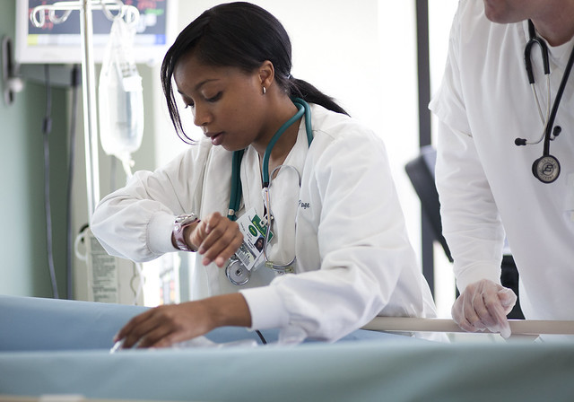
Registered Nurse (RN)
According to the American Nurses Association, nursing is defined as "the protection, promotion, and optimization of health and abilities, prevention of illness and injury, alleviation of suffering through the diagnosis and treatment of human response, and advocacy in the care of individuals, families, communities, and populations."
Professional nurses have the designation of Registered Nurse (RN), which is achieved through the completion of a rigorous educational program and successfully passing a licensing examination. Nurses may have associate, baccalaureate, master's or doctorate degrees. SRJC prepares professional nurses at the associate degree level.

Slide 7

Registered Nurse (RN)
The SRJC Associate Degree Nursing (ADN) Program is one of the top ADN programs in California. Since beginning in 1959, the program has enjoyed a wonderful working relationship with numerous clinical agencies in Sonoma County. Approximately 60 new students are admitted each fall and spring semester. Our nursing students come from varied educational and culturally diverse backgrounds and life experiences. Nurses that graduate from our program are prepared to work in a variety of health care settings.
Please read through the SRJC’s ADN website and FAQ’s:
  https://adn.santarosa.edu/ (check this website often)
  https://adn.santarosa.edu/frequently-asked-questions

Slide 8
How to become a Registered Nurse
Master’s Degree Program (MSN)
Bachelor’s Degree Program (BSN)
Associate Degree Program (ADN)
Complete Nursing Degree Pass NCLEX-RN Exam Receive RN License

Slide 9

Preparation for SRJC’s ADN Program
Board of Nursing Requirements
Associate Degree Graduation Requirements
Science Prerequisites

Slide 10
S.R.J.C. Associate Degree Nursing Preparation Worksheet
KEY
Science Prerequisites
Anatomy 1
Physiology 1
Microbiology (Micro 5
or Micro 60 or HLC 55)
Board of Registered Nursing Requirements
Food & Nutrition and Psychology MUST be completed by the application deadline
Prerequisite
*Anatomy 1
5 units
Food & Nutrition 62 OR 10**
Psychology 1A or 4 or 7 or 8 or 56**
Sociology 1 or 2 or 10 or 30 or
Anthropology 2 or 21
Comm 1 or 3 or 4 (previously Comm 60) or
5 or 6 or 7
English 1A or ESL 10*
Recommended
Biology 10 &
English 1A
4 units each
Bio 10
prerequisites
are completion of
Math 150 or
qualifying test
scores.
*Physiology 1
5 units
@Remaining Associate Degree General Education Requirements
(Option A)
Must be completed by graduation
Communications an Analytical Thinking
(Area B), (Comm 1 or 3 or 4 or 5 or 6 meet this requirement)
Social & Behavioral Sciences (Area D)
(Psych 1A or 4 or 7 or 8 meet this requirement)
Humanities (Area E)
American Institutions (Area F)
American Cultures (Area G)
(Anthro 21, Soc 30 or Comm 7 meet this requirement)
Glbl Prspect & Environ. Literacy (Area H)
Information Literacy (Area I)
Math Competency
Chemistry 60
5 units
*Microbiology 5
5 units
or
*Microbiology 60
4 units
Completion of
Math 150
recommended
NOTES
*English, Anatomy 1, Physiology 1, Microbiology (Micro 5, or Micro 60 or HLC 55), MUST be completed by the end of the fall semester of application in order to meet admission requirements.
**Beginning for the Fall 2024 application cycle, the TEAS MUST be completed by the application deadline.
Bio 100 is a prep course for Bio 10; Chem 100 is a prep course for Chem 60.
HLC 55 (Health Care 55) was not offered after Spring 2010, however, students who previously completed this course may still use it to meet the microbiology requirement.
@ An Associate Degree or higher is required to take the NCLEX-RN
Revised 1/2025

Slide 11

SRJC Associate Degree Graduation Requirements
To be eligible to sit for the NCLEX-RN exam, students must complete the Nursing Major and General Education Requirements for an Associate of Science Degree at SRJC
  General Education Patterns:
    GE option A (local)
    GE option B (CSU)
    GE option C (IGETC)

Slide 12
SRJC Associate Degree Graduation Requirements
It is important to work with a counselor to make sure all prerequisites for admission to the ADN program are met by application deadline and that a education plan is made for general education and graduation requirements.
Students with an Associate Degree from SRJC may need to meet new general education areas if there has been a break in enrollment.
Students with an Associate Degree from another Community College must complete any missing SRJC general education and graduation requirements not fulfilled at the previous institution.
Students with a Bachelor Degree from a Regionally Accredited University are exempt from SRJC’s general education requirements.
  Official transcripts must be sent to SRJC Admissions and Records office with an evaluation request.

Slide 13
ADN Screening and Selection Criteria
College GPA within 5 years prior to the fall semester of application to the nursing program (degree applicable courses only)
  If a student has not completed at least 24 units within the past 5 years, the overall GPA will be calculated using all prior college courses
Grade in English 1A or equivalent
  Students who tested out of or have an AP score for English 1A may use English 1B or 5 to meet this requirement
  The most recent English 1A or equivalent will be used for the cut-score
GPA in the core science classes: anatomy, physiology and microbiology
  English, anatomy, physiology, and microbiology must be completed by the end of the fall semester of application to be considered for the applicant pool
  Food & Nutrition and Psychology must be completed by application deadline
Core Biology Repetitions
  The number of repeats (including W’s and NC) in the core science classes within last 5 years prior to the fall semester of application earns a deduction

Slide 14
Chancellor’s Formula: Sample probability of success scores
Student | College GPA | Core Biology GPA | English GPA | Core Biology Repetitions | Computed Probability of ADN Program Completion
English Grade = 4.0
Student Example 1 | 2.8 | 2.66 | 4.0 | 0 | 82%
Student Example 2 | 2.9 | 2.0 | 4.0 | 0 | 80%
Student Example 3 | 3.0 | 3.0 | 4.0 | 1 | 80%
Student Example 4 | 3.2 | 3.66 | 4.0 | 1 | 83%
Student Example 5 | 2.75 | 3.33 | 4.0 | 0 | 85%
Student Example 6 | 2.9 | 2.0 | 4.0 | 1 | 74%
Student Example 7 | 3.33 | 4.0 | 4.0 | 2 | 80%
English Grade = 3.0
Student Example 8 | 3.0 | 3.0 | 3.0 | 0 | 80%
Student Example 9 | 3.0 | 3.0 | 3.0 | 1 | 74%
Student Example 10 | 2.75 | 3.33 | 3.0 | 0 | 80%
Student Example 11 | 2.8 | 2.66 | 3.0 | 0 | 77%
Student Example 12 | 3.2 | 3.66 | 3.0 | 1 | 78%
Student Example 13 | 3.5 | 3.64 | 3.0 | 1 | 80%
Student Example 14 | 3.7 | 3.33 | 3.0 | 1 | 80%
English Grade = 2.0
Student Example 15 | 3.4 | 3.64 | 2.0 | 0 | 80%
Student Example 16 | 3.2 | 4.0 | 2.0 | 0 | 80%
Student Example 17 | 4.0 | 4.0 | 2.0 | 1 | 79%
Student Example 18 | 3.33 | 3.66 | 2.0 | 0 | 80%
Student Example 19 | 3.6 | 3.33 | 2.0 | 0 | 80%

Slide 15

ADN Application/Screening Process
Students will be selected at random from the pool of students who meet the ADN Program’s eligibility standards
All eligible students receive a number. The program has been admitting 120 students, 60 begin in the fall, 60 begin the following spring.
Apply Oct. 2nd to Feb. 7th each year*
  https://adn.santarosa.edu/getting-started

Slide 16
TEAS Information
The ATI-TEAS is a test of essential academic skills for nursing students. It tests science, math, reading, and English language and usage.
SRJC requires a score of 62 to enter the ADN program.
TEAS needs to be done by application deadline.

Slide 17

TEAS Information
If a student does not earn the required score of 62, they will be referred for remedial coursework that will prepare the student to retest
The student has a year to retest and will be able to begin the ADN program as soon as possible after earning the required TEAS score

Slide 18
TEAS Information
Also required for CSU nursing programs. The cut score is 78 at SSU (this can vary by CSU). If a student has taken the test for CSU, they can have the results sent to SRJC (must be the same version currently being used at SRJC)
Students can prepare for the TEAS test by purchasing the review package and online practice test at www.atitesting.com
There are 2 study guides for the TEAS on reserve in the Doyle and Mahoney Libraries

Slide 19
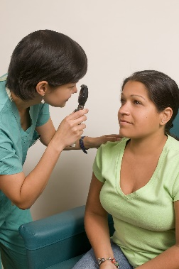


Starting SRJC’s ADN Program
Upon acceptance into the ADN program, the student must complete or obtain the following:
  Physical examination
  Required documentation including proof of vaccinations
  Current Health Care Providers CPR certification for adults, children and infants
  Background check

Slide 20
Background Checks
An identity confirmation (fingerprinting) and background check will be conducted on all students admitted to health science programs before they begin
The background check looks for:
  Valid Social Security Number
  Felony and misdemeanor convictions
  Government fraud convictions

Slide 21
Background Checks
Local hospitals will not accept students who do not have a valid social security number or tax id number, or who have a recent DUI
A criminal conviction is not considered complete until the probation period is over (some DUI convictions have 3-4 years of probation)
Students with more than one DUI or an arrest related to violence are automatically denied for clinical
The California Board of Registered Nursing may deny licensure to anyone who has been convicted of a felony or misdemeanor. Contact the Board of Registered Nursing web site for more information www.rn.ca.gov

Slide 22

SRJC’s ADN Program Facts
Costs are approximately $6,000 and include SRJC fees, books, lab kits, stethoscopes, equipment, and uniforms
A personal computer with Internet access is highly recommended
Students are required to travel to many different clinical sites, so reliable transportation is also necessary

Slide 23
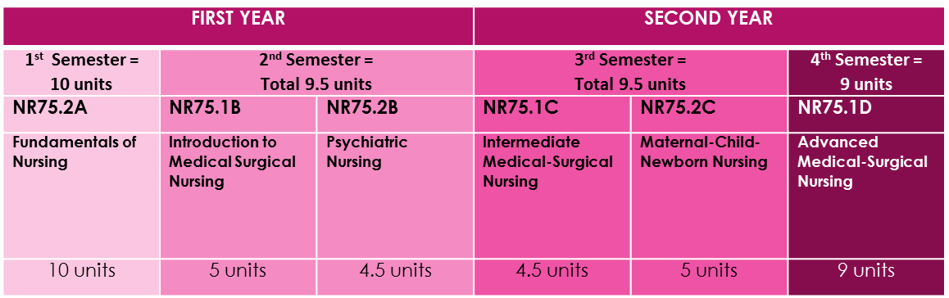
SRJC’s AND Program Facts
Associate Degree Nursing 38 Unit Curriculum

Slide 24
SRJC’s ADN Program Facts
Breakdown of Semester Hours by Course Component
Course | Course Units | Lecture | Skills Lab | Clinical | Simulation | Preceptorship | Total Semester Hours
NR75.2A | 10 | 87 | 68* *Most in first 6 weeks of semester | 186** **over 11 weeks | 8*** Two 4 hour rotations |  | 350
NR75.1B | 5 | 40 | 10 | 110 | 6 |  | 160
NR75.2B | 4.5 | 36 | 16 | 81 | 8 |  | 108
NR75.1C | 4.5 | 36 | 22 | 88 | 6 |  | 108
NR75.2C | 5 | 40 | 9 | 94 | 17 |  | 160
NR75.1D | 9 | 78.75 | 6 | 126.25^ ^first 10 weeks | 8 | 96^^ ^^last 7 weeks of last semester | 315

Slide 25
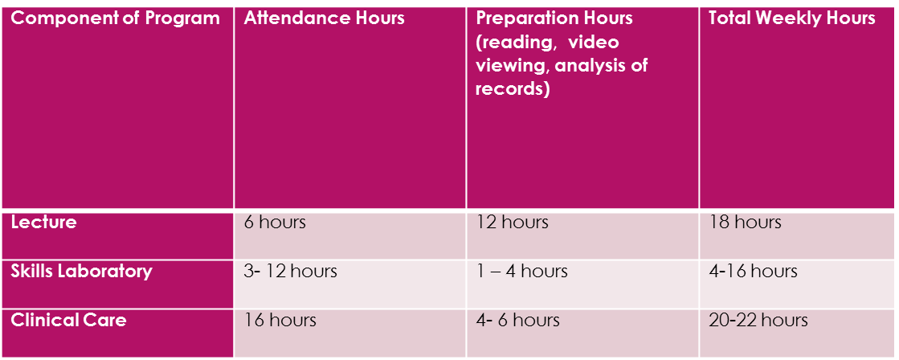
SRJC’s ADN Program Facts
Average Weekly Time Commitment for ADN Program

Slide 26

SRJC’s ADN Program Facts
Strict Program Policies
  To proceed in the program, students must pass 4 exams in each sequential course with a minimum score of 75%
  Students must comply with all health requirements
  Dress Code is required for skills lab and clinical experiences
  Absences: can result in a failing grade
    Cannot miss more than 10% of lectures
    Maximum of 2 absences in skills and clinical
    Excessive tardiness can equal an absence

Slide 27
SRJC’s ADN Program Facts
General Workload
  Read 60-100 per week
  Written assignments: Nursing Care Plans, Journals
First Semester
  Approximately 50 hours per week for the 1st semester and slightly decreases in the later semesters
  1st semester is 5 days per week on campus for the first 6 weeks. Hours vary between 2-6 hours each day in either lecture or skills lab
Final Semester Preceptorship
  The preceptorship during the last semester requires each student to work the same schedule as the nurse to whom they are assigned

Slide 28

SRJC’s ADN Program Facts
Clinical = two 8 hour days a week
  Tues/Wed OR Sat/Sun from 6:30-2:30 or 1:30-10:30
  Clinical assignments can be anywhere in Sonoma county
  Student work schedules are not considered when making assignments
  Students must go to their assigned hospital the day before clinical to assess patient records (2-3 hours)
  Students must then prepare documents and care plans for the next day’s work (2-4 hours)

Slide 29

ADN-BSN Bridge at SSU
CNECM or CPOST –
  Partnership between SSU and Community College
  Qualified and admitted ADN students enroll in BSN courses at Sonoma State University while enrolled in the ADN program
  https://nursing.sonoma.edu/academic-programs/post-licensure-bsn/post-licensure-requirements
TPOST-
  Traditional Bridge Program for Licensed RN’s
  Currently on hold at SSU
  Many other options for post bridge programs

Slide 30

Sonoma State’s BSN Program
Admit approximately 24 students each Fall
  https://nursing.sonoma.edu/academic-programs/pre-licensure-bsn
  Selection criteria:
  https://docs.google.com/document/d/1KOXCKj2ia0Do8JtEXLu1iXL7mkD_CV4z/edit

Slide 31

Strategies for Success
It is recommended that students take one science per semester along with other non-science prerequisites if needed
  The core science courses are rigorous and time consuming
If you must take two sciences, the following sequence is suggested:
  Bio 10 and Chem 60
  Anat 1
  Physio 1
  Micro 5 or 60

Slide 32

Strategies for Success
Be realistic about your schedule
  Successful completion of the prerequisites requires outside planning and work
If you are working full-time or have family responsibilities, you may want to limit your units
Get help from the Tutorial Center early in the semester
Form your own student groups to assist with your learning

Slide 33
Submitting Transcripts
Submit official transcripts to Admissions and Records for evaluation as soon as possible
  Request an evaluation:
  https://admissions.santarosa.edu/transfer-credit-evaluation-form
Official transcripts of coursework completed at another institution must also be submitted to the nursing department at the time of application to the Nursing Program
Unofficial transcripts for coursework completed at SRJC must be submitted to the nursing department at the time of application to the Nursing Program

Slide 34

SRJC has services to help you be successful! https://www.santarosa.edu/students
Career Center/Hub
Counseling
Disability Resources
EOPS
Financial Aid/Scholarship Office
Learning Communities
Student Health and Psychological Services
Student Life
Student Employment
Tutorial Center
Transfer Center
Veteran’s Affairs
Welcome and Connect Center
Work Experience

Slide 35

Remember to check in with your counselor each semester.

